Slide 1

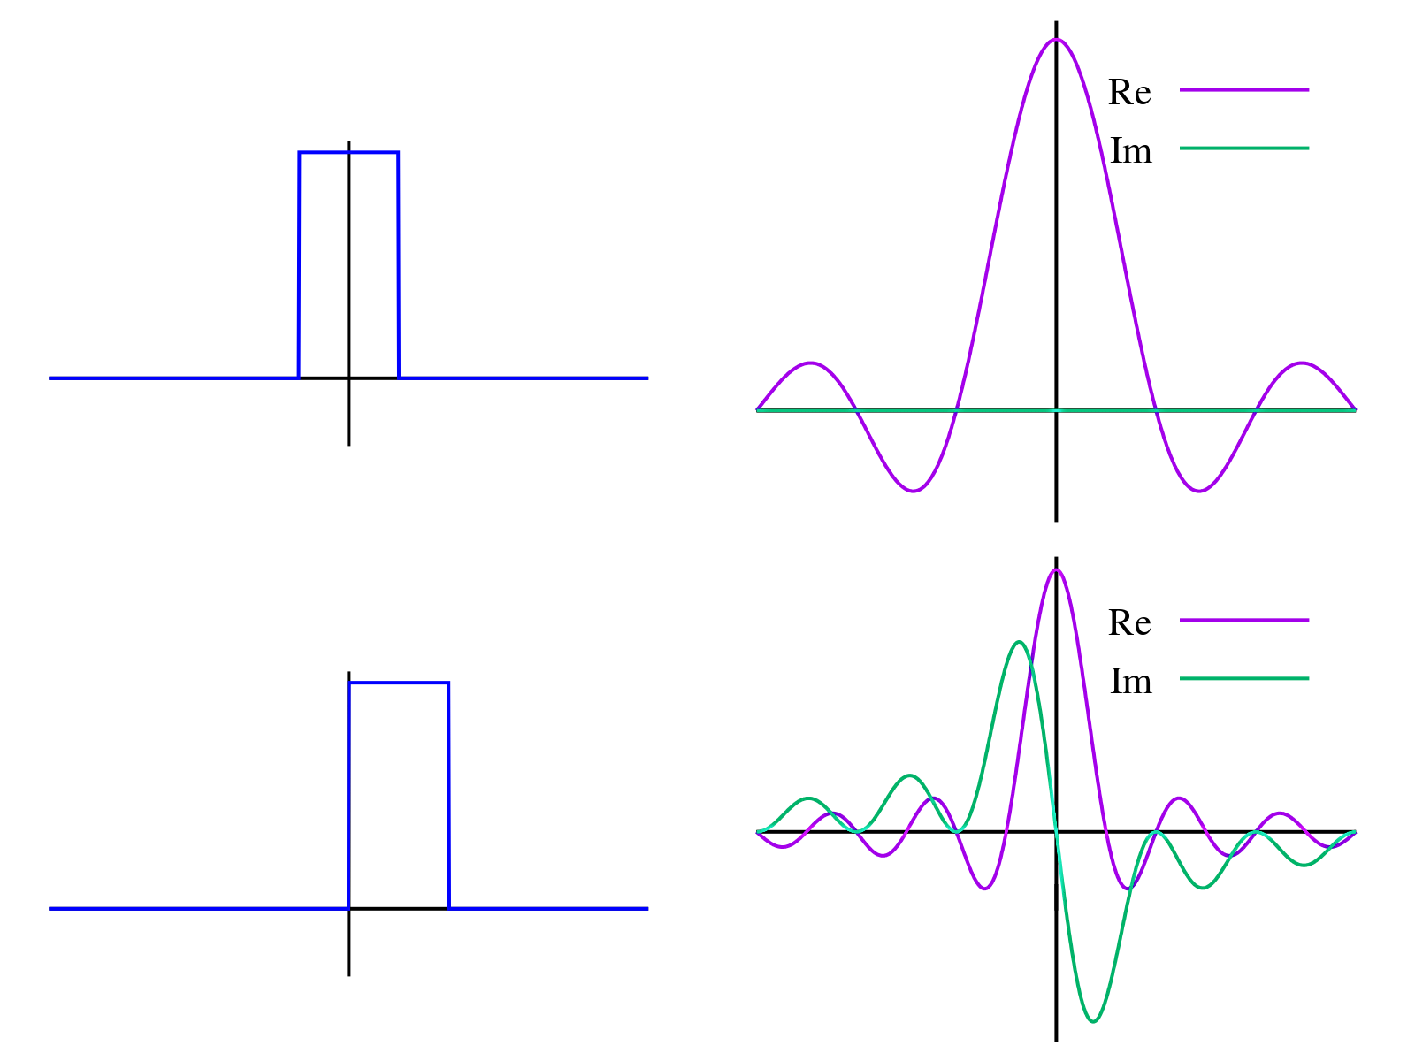

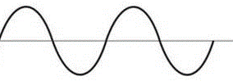
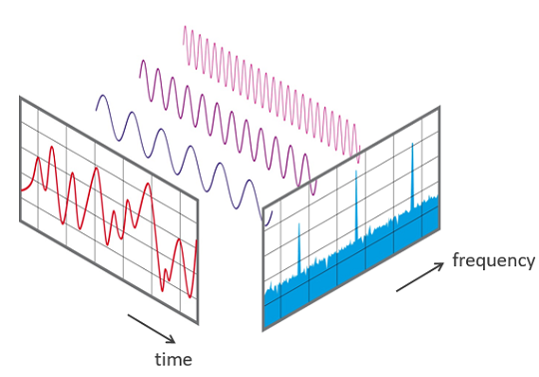
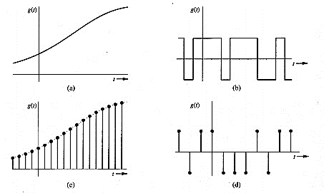
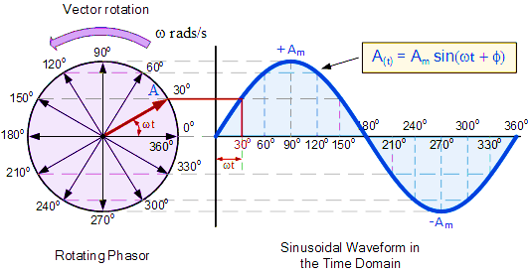
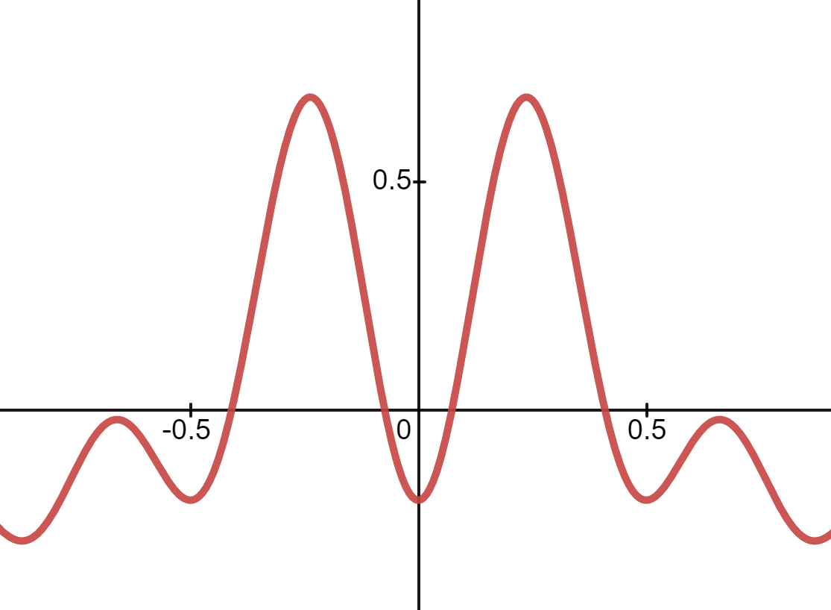
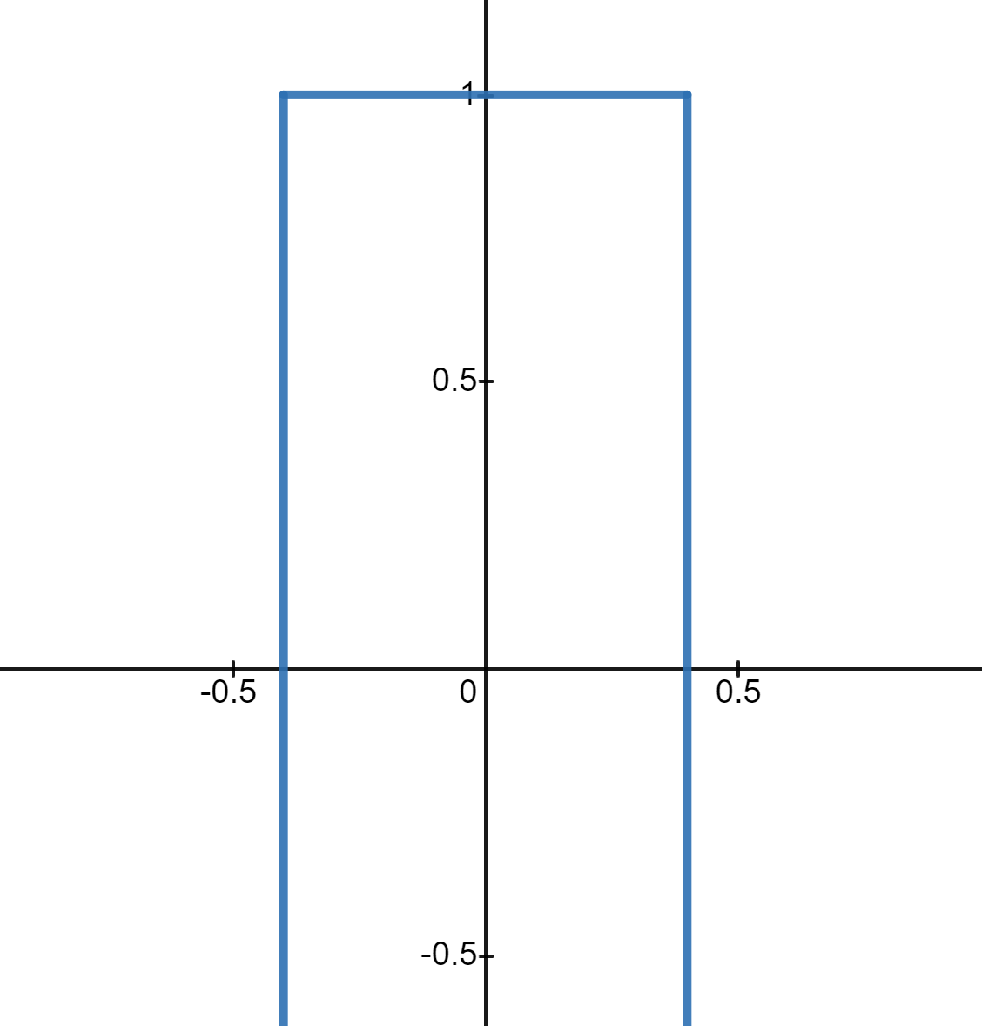
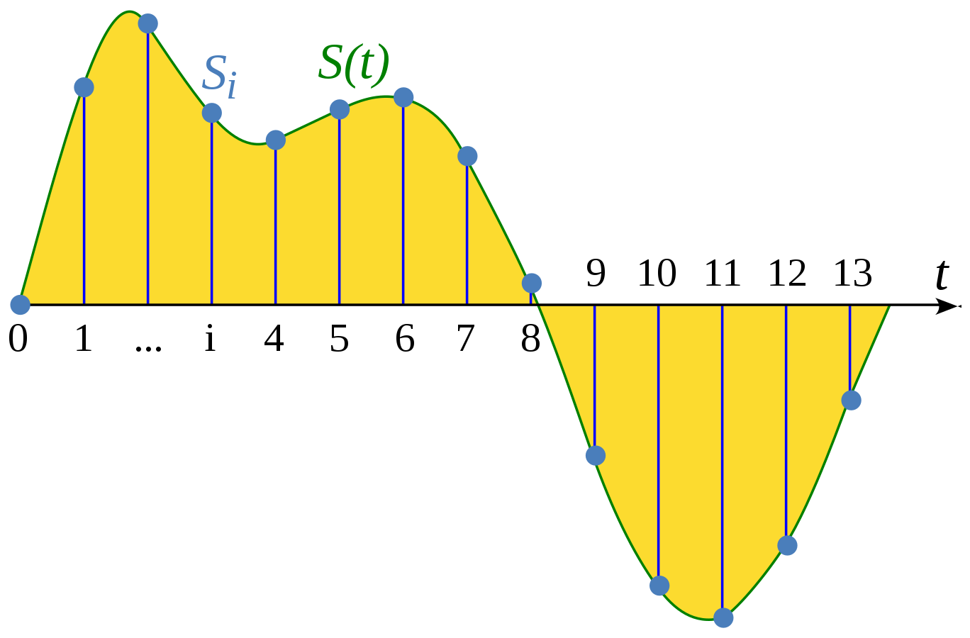
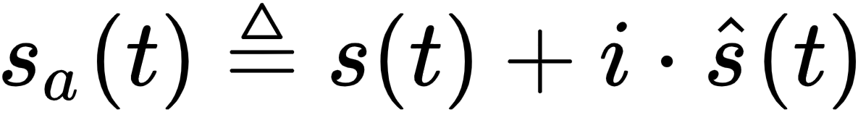
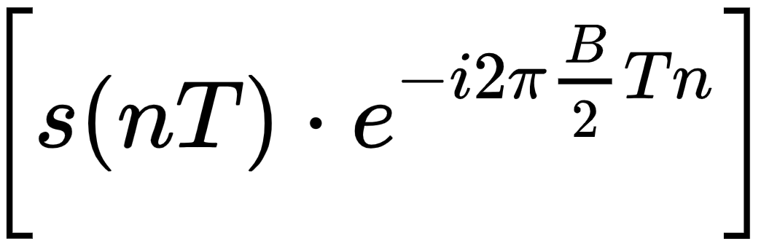













K. J. Somaiya College of Engineering, Mumbai – 400 077
(A Constituent College of Somaiya Vidyavihar University) Dept. of Science and Humanities
F.Y. B. Tech. Semester –I (2020-21)
Applied Mathematics-I IA-II
Name : Hardik Shah
Roll No. : 16010221025
Batch : D2
Branch : ETRX
Application Of Complex Numbers in Signal Analysis
Complex Numbers have unique property of representing and manipulating two variables as a single quantity. That fits very naturally with Fourier analysis, where the frequency domain is composed of two signals. Complex numbers shorten the equations used in DSP (Digital Signal Processing), and enable techniques that are difficult or impossible with real numbers alone.
Fourier transforms
(Machine Learning Algo.)
Discreet Fourier Transformation (DFT)
Fast Fourier Transformation (FFT)
Phasors
The DFT is a v. imp. discrete transform, used to perform Fourier analysis. In DPS, the function is any quantity or signal that varies over time, such as the pressure of a sound wave, a radio signal, or daily temperature readings, sampled over a finite time interval
It’s an algorithm that computes the DFT of a sequence, or its inverse.
It is an effective method to convert the incoming waveform from its original domain to a representation in the frequency domain and vice versa.
C.N. = $e^{iθ}$
It is a mathematical transform the decomposes functions depending on space or time into functions depending on spatial or temporal frequency, such as musical signals.
$θ$ can be replaced by:
C.N. = $e^{iωt}$
To plot electrical signals as a function of time, we use complex numbers
$$F\left(ω\right)=\frac{1}{\sqrt{2π}}\int_{−∞}^{∞}{f\left(t\right)ⅇ^{−ⅈωt}ⅆt}$$
$$F_{k} =\sum_{j=0}^{N−1}{\left(f_{j}e^{\frac{−2πijk}{N}}\right)}$$
$$f\left(t\right)=\frac{1}{\sqrt{2π}}\int_{−∞}^{∞}{F\left(ω\right)ⅇ^{−ⅈωt}ⅆω}$$
$$F_{j} =\frac{1}{N}\sum_{k=0}^{N−1}{\left(F_{k}e^{\frac{2πijk}{N}}\right)}$$
Area under curve
remains same
Digital Signal Processing:
When one waveform, the Hilbert transform of the other waveform, the complex valued function, is called an analytic signal.
Sources:
google.com
Steve Spicklemire
anolog.com -> pdf
Wikipedia
Harvard University
Research Gate

Slide 2
Just in case, the fonts or if any other file doesn’t support, there’s a screenshot on the next slide

Slide 3
